Slide 1


SIMATS ENGINEERING
SAVEETHA INSTITUTE OF MEDICAL AND TECHNICAL SCIENCES
Porter Stemmer: Design, Working Mechanism, and Applications
Student Name: ALLAPAREDDY JAHNAVI Register Number: 192472214
COURSE CODE :DSA0302
COURSE : NATURAL LANGUAGE PROCESSING
Faculty:Dr. DEVI

Slide 2
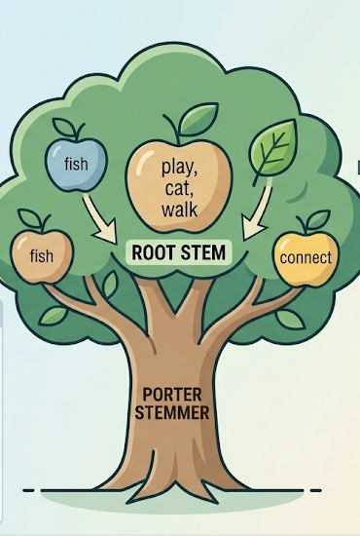
INTRODUCTION
Natural Language Processing (NLP) processes human language for tasks such as search, text classification, and sentiment analysis.
The same word often appears in multiple forms (e.g., play, playing, played, plays), increasing vocabulary size and processing complexity.
Porter Stemmer is a rule-based stemming algorithm developed by Martin Porter (1980) that removes common suffixes to generate the root form (stem) of a word.
By reducing word variations to a common stem, it improves search accuracy, text preprocessing, and information retrieval.
Porter Stemmer is one of the most widely used preprocessing techniques in NLP due to its simplicity, speed, and efficiency.

Slide 3


PROBLEM CONTEXT
Natural language contains multiple forms of the same word, such as play, playing, played, and plays.
These variations increase the vocabulary size, making text processing more complex.
Search engines and NLP systems may treat each word form as a separate term, reducing search accuracy.
Processing redundant word forms increases storage requirements and computational time.
Word variations can affect the performance of information retrieval, text classification, and sentiment analysis.
An effective preprocessing technique is needed to convert different word forms into a common root word.
Need for Porter Stemmer
Reduces word variations to a common stem.
Decreases vocabulary size and processing time.
Improves search accuracy and document retrieval.
Enhances the performance of NLP and machine learning applications.

Slide 4
RULE-BASED APPROACH
Porter Stemmer works using a set of predefined linguistic rules.
The algorithm identifies common suffixes such as -ing, -ed, -s, -ies.
It removes or replaces these suffixes to obtain the stem.
Rules are applied in multiple sequential steps until the final stem is generated.
The algorithm focuses on word structure rather than meaning or context.
Common Rules
Rule | Example
ing → "" | Playing → Play
ed → "" | Connected → Connect
ies → i | Studies → Studi
s → "" | Cats → Cat

Slide 5
APPLICATION
Example of Porter Stemming
Input Sentence
The players were playing and played football every day.
Tokenization
The
players
were
playing
and
played
football
every
day
After Porter Stemming
Original Word | Stem
players | player
playing | play
played | play
football | football
Observation
Different word forms are reduced to a common stem.
Vocabulary size is minimized.

Slide 6

ROLE IN INFORMATION RETRIEVAL SYSTEMS
Reduces multiple word forms into a single stem.
Improves search engine accuracy by matching related words.
Decreases vocabulary size, reducing storage requirements.
Improves the performance of search engines, digital libraries, and recommendation systems.
Real-Time Example
User Search
playing football
Documents
He played football.
She is playing football.
Football players are talented.
After Porter Stemming
play football
Result: All relevant documents are successfully retrieved.

Slide 7


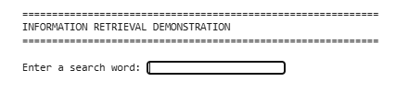
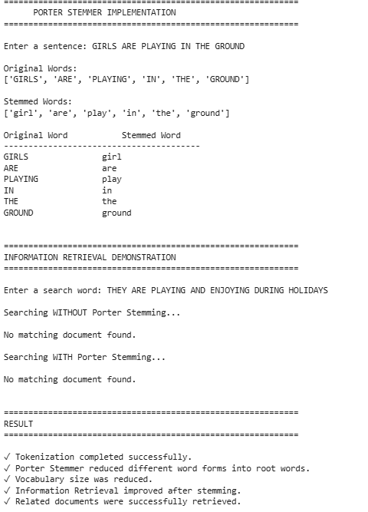

IMPLEMENTATION:
INPUT:
OUTPUT:

Slide 8
RESULT AND CONCLUSION
Advantages
Fast and efficient algorithm.
Simple rule-based implementation.
Reduces vocabulary size.
Improves search accuracy.
Widely used in NLP preprocessing.
Conclusion
Porter Stemmer is an effective rule-based stemming algorithm.
It removes suffixes to produce root words.
It plays a vital role in text preprocessing and information retrieval.
Its simplicity and speed make it a popular choice for many NLP applications.
SAMPLE OUTPUT
Input | Output
Playing | Play
Studies | Studi
Connected | Connect

Slide 9
THANK YOU

